Slide 1

Firewall and network management In hybrid cloud
Team :
M.DHANUSHKARTHIKEYAN - 002
B.JAYA ESWARAN - 010
A.SACHIN JOSHUA - 021
P.SAM PRASANNARAJ - 022
Guide:
Mr. DIJU DANIEL M.E., AP/ECE.,

Slide 2
introduction
Setting up a hybrid cloud platform in a small scale will help to manage and compute the data scraps everywhere. But network security should be managed properly to maintain privacy.
As cloud computing technology continues to grow at a rapid pace, it introduces even more vulnerabilities
Even in personal and home cloud this will be a much bigger problem without network security.
So we building a data sharing hybrid cloud in a home network. And developing the cloud Based firewall and network managing system

Slide 3
objective
To build a low cost, scalable home hybrid cloud .
Maintaining the network security and firewalls.

Slide 4
Existing method
Software-defined networking (SDN) can be used to provide security over the cloud in several ways, such as follows:
Network Segmentation With SDN, you can segment your network to isolate different types of traffic, such as web traffic, application traffic, and database traffic. This helps to prevent the spread of threats and malware across your network
Access Control: SDN can be used to create and enforce access policies for different types of users, devices, and applications. For example, you can use SDN to create a virtual private network (VPN) to securely connect remote users to your cloud infrastructure

Slide 5
Drawback of existing methods
Attackers can focus on compromising the SDN controller If the attacker successfully gains access, the compromised SDN controller can be used to direct the network devices it controls
Communicating messages between the control plane layer and the data plane layer is subject to man-in-the-middle attacks
These are only for large scale industrial networks and not for small scale networks and not cost effective
High cost
SDN have no vritual firewall

Slide 6
Proposal method
Building a home data sharing cloud we using the Azure and deploying the VMs to manage files and secure the pubic cloud side of the hybrid cloud
We using Hyper V for the on premise VMs
Connecting Azure arc and hyper V VMs in a hybrid architecture
We can migrate the servers and network between private and public clouds
We can configure the firewall with Azure cloud-based managed firewall to secure the VMs and other network resources and configuring alerts system
Network can be managed with either Azure network manager or local machine networks

Slide 7
components
software:
Windows pro
Azure (free/paid)
Hyper V hypervisor
VM operating system
Hardware:
Spear server/medium spec laptop or PC(home cloud)

Slide 8
Hyper v
Hyper V is a windows server based virtualisation platform it can also be called as hypervisor
Hyper-V specifically provides hardware virtualization. That means each virtual machine runs on virtual hardware.
Hyper-V is available on 64-bit versions of Windows 10 Pro, Enterprise, and Education. It is not available on the Home edition.

Slide 9
azure
Azure is a public cloud provider platform
Azure provides various types of services included storage, computing, network even for free trails
We are using computing , arc for managing and firewall manager in this project
All the service are completely virtual.

Slide 10
why Azure and hyper v
Azure
Hyper V
Flexible
Low cost
Scalable and high-performance
Low latency
It is a hypervisor
Easy to use
Comes inbuilt with windows pro operating systems
We can split the resources as much as we need

Slide 11
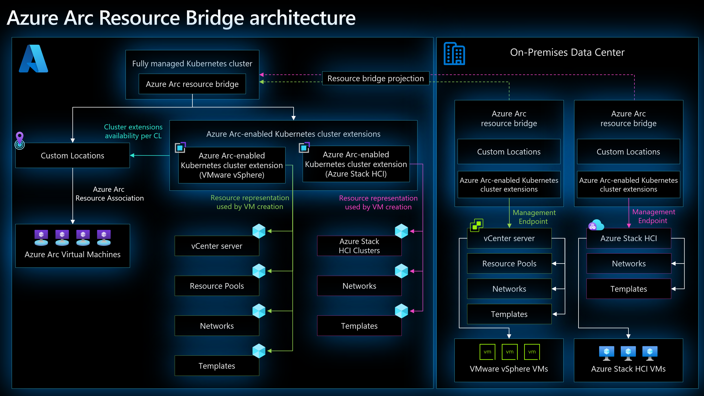
Azure arc architecture

Slide 12
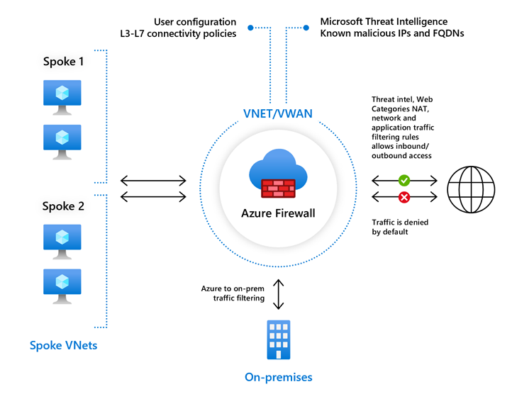
Azure cloud based firewall
Azure Firewall is a cloud-native and intelligent network firewall security service that provides the best of threat protection for your cloud workloads running in Azure. It's a fully stateful firewall as a service with built-in high availability and unrestricted cloud scalability. It provides zero maintenance and trust over networks. We can configure inbound and outbound policies .

Slide 13
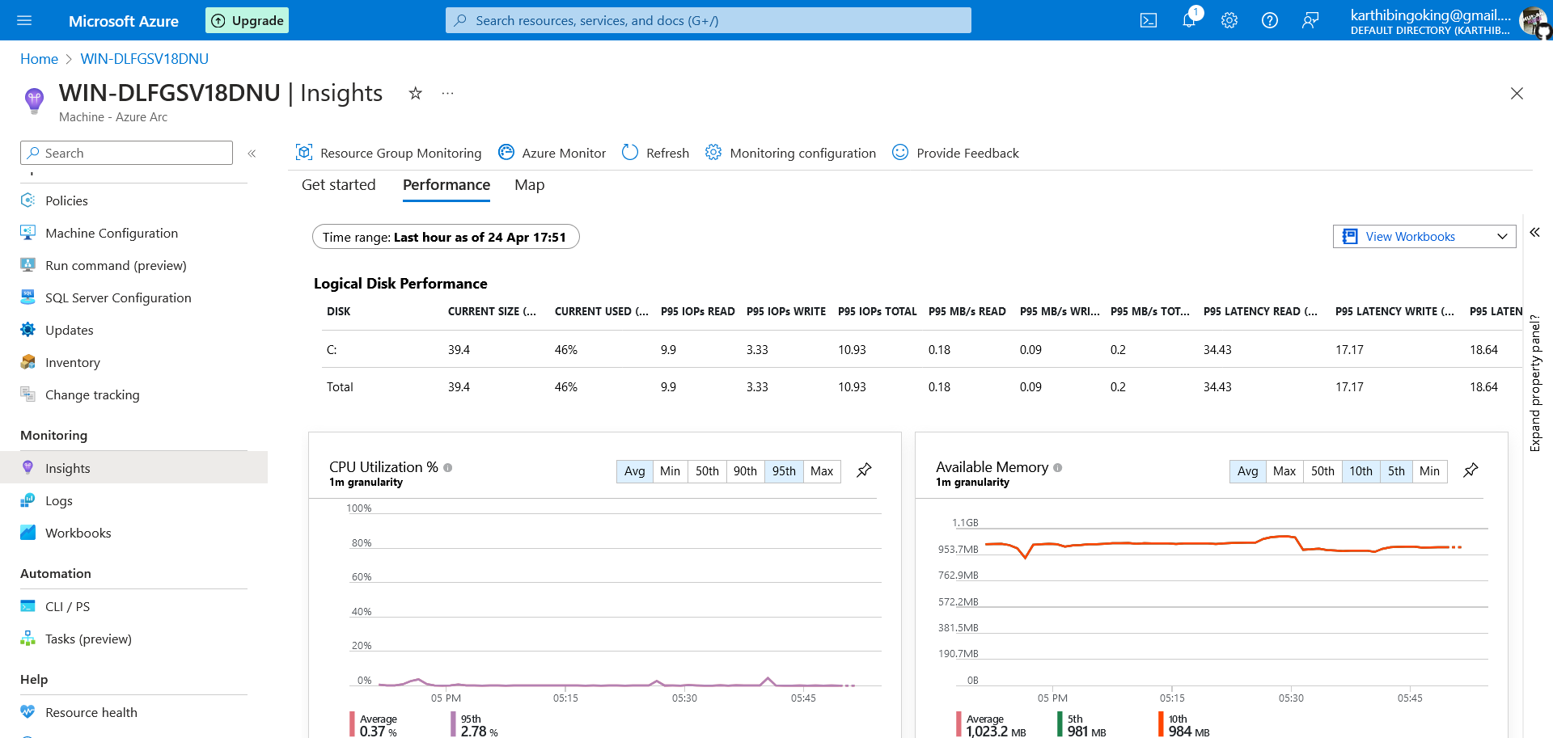
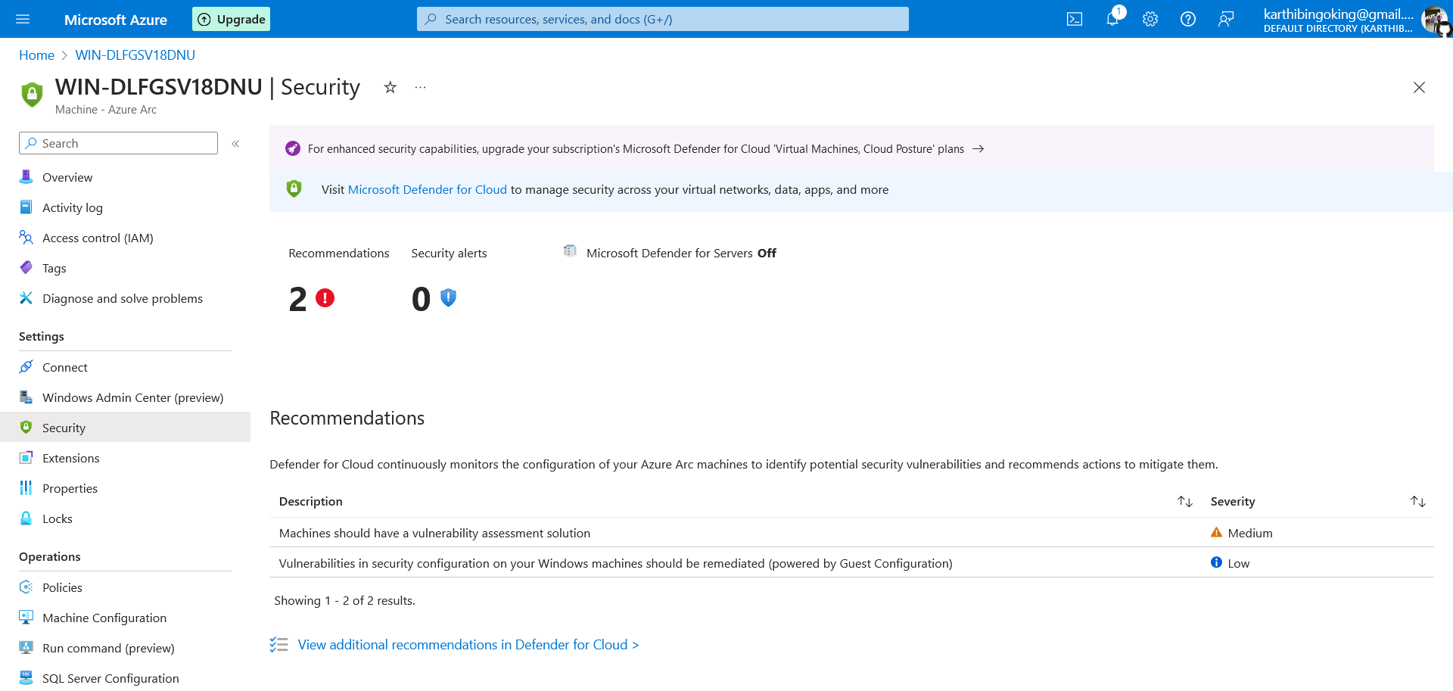
System management & monitoring
Realtime system and network monitoring
Remote access to the CLI or Power shell
Real time security
Remote update
Threat or fault detection
Addable extinctions

Slide 14
Network management
On-premise
Public cloud
Hyper v provides a high-end network architecture for the VM
We can configure VMs either with or without network switch
We can use most of the network protocells like TCP,SSH,HTTP,HTTPS and etc..,
Azure have set of virtual network architectures and the provide highspeed connectivity and latency
They provide various virtual network service components like network switch , firewall , router ,load balancers and network managers

Slide 15
Migration
Migration can be done by transferring data or the entire server from either one host to another or physical machine to virtual
We can use Azure migrate or AD connect or Arc SCVMM to migrate systems to azure
We can also install third-party migrations tools to migrate data between cloud Example : VM ware Vcenter

Slide 16
Advantages
Low cost home data sharing hybrid cloud
Removes the past data breaches and issues
By replacing the SDN with cloud-native firewall will give a high security with a centralised platform
Arc enabled hybrid compute architecture is scalable so it can be upgraded as per the requirements
Azure gives the optimised solution for systems management and monitoring

Slide 17
Use cases
Cloud computing can be used everywhere using the internet
Network and fire wall management provides security
Low cost and effective cloud solution
Virtualization of computation
Real-time network monitoring
automation

Slide 18
conclusion
The azure arc and hyper v based hybrid cloud have been built . The network and firewalls has been managed. systems are working properly as expected
We are providing a easy implementation method of a hybrid cloud structure
Which can be used for home automation and data-centres. This method can be upgraded and utilised asper the scale and parameters of the hardware

Slide 19
Thanking you

